Slide 1
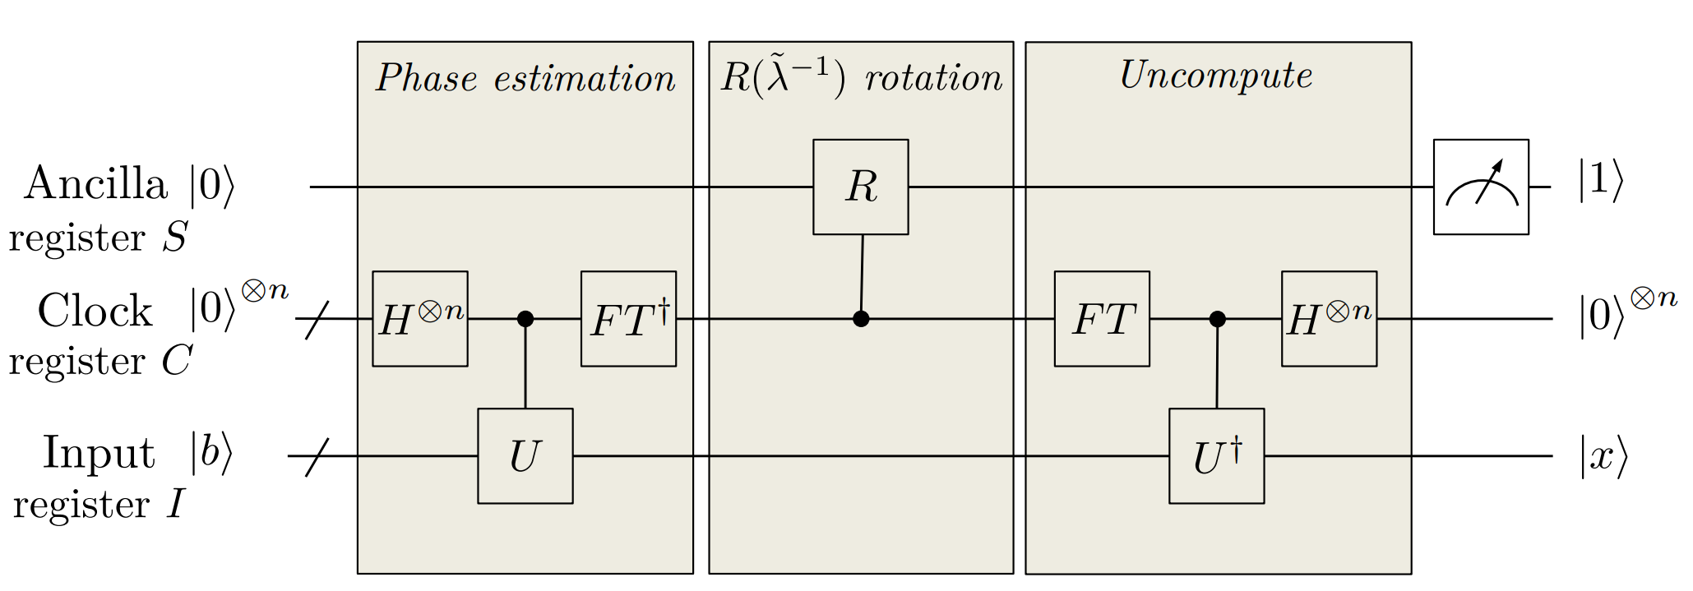
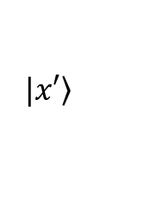


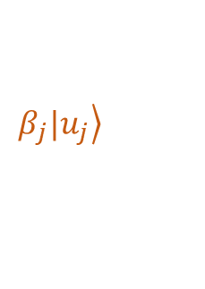
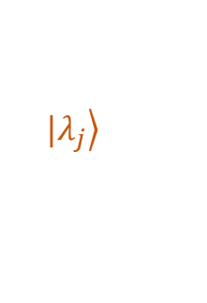
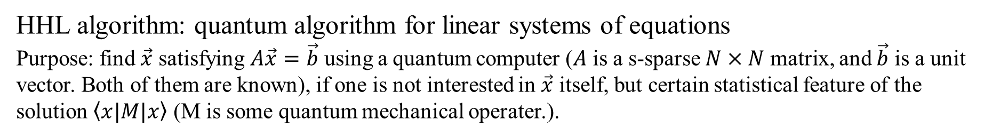
HHL algorithm: quantum algorithm for linear systems of equations
Purpose: find $\vec{x}$ satisfying $A\vec{x}=\vec{b}$ using a quantum computer ($A$ is a s-sparse $N×N$ matrix, and $\vec{b}$ is a unit vector. Both of them are known), if one is not interested in $\vec{x}$ itself, but certain statistical feature of the solution $\left\langle x|M|x\right\rangle$ (M is some quantum mechanical operater.).
Inverse phase estimation
$$|\left.λ_{j}\right\rangle$$
$$β_{j}|\left.u_{j}\right\rangle$$
$$|\left.x′\right\rangle$$
$$|\left.b\right\rangle =\sum_{i=1}^{N}{b_{i}|\left.i\right\rangle }$$
$$A→U= e^{iAt}$$
Reference: Harrow A W, Hassidim A, Lloyd S. Quantum algorithm for linear systems of equations[J]. Physical review letters, 2009, 103(15): 150502.
Picture: https://arxiv.org/pdf/1802.08227.pdf

Slide 2
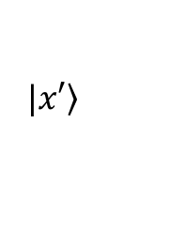
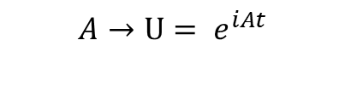
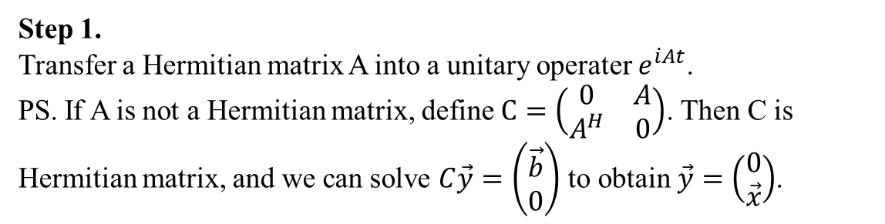
The procedure for HHL algorithm
$$|\left.x′\right\rangle$$
Step 1.
Transfer a Hermitian matrix A into a unitary operater $e^{iAt}$.
PS. If A is not a Hermitian matrix, define $C=\left(\begin{matrix}0 & A \\ A^{H} & 0\end{matrix}\right)$. Then C is Hermitian matrix, and we can solve $C\vec{y}=\left(\begin{matrix}\vec{b} \\ 0\end{matrix}\right)$ to obtain $\vec{y}=$ $\left(\begin{matrix}0 \\ \vec{x}\end{matrix}\right)$.
$$A→U= e^{iAt}$$

Slide 3

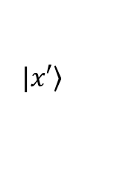
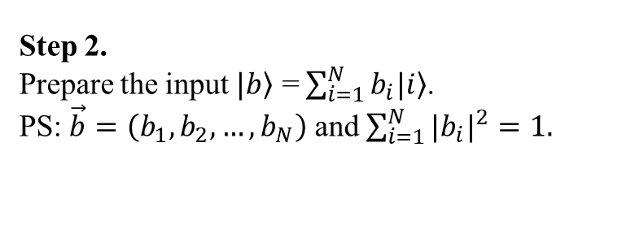
The procedure for HHL algorithm
$$|\left.x′\right\rangle$$
$$|\left.b\right\rangle =\sum_{i=1}^{N}{b_{i}|\left.i\right\rangle }$$
Step 2.
Prepare the input $|\left.b\right\rangle$ = $\sum_{i=1}^{N}{b_{i}|\left.i\right\rangle }$.
PS: $\vec{b}=\left(b_{1},b_{2},…,b_{N}\right)$ and $\sum_{i=1}^{N}{{{|b}_{i}|}^{2}}=1.$

Slide 4
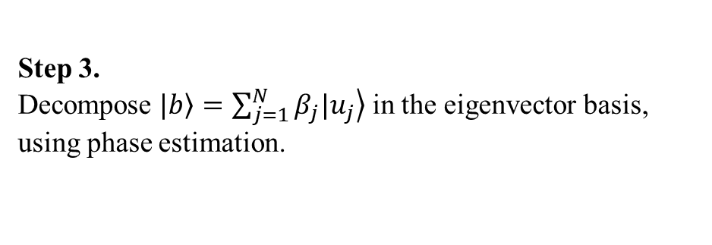
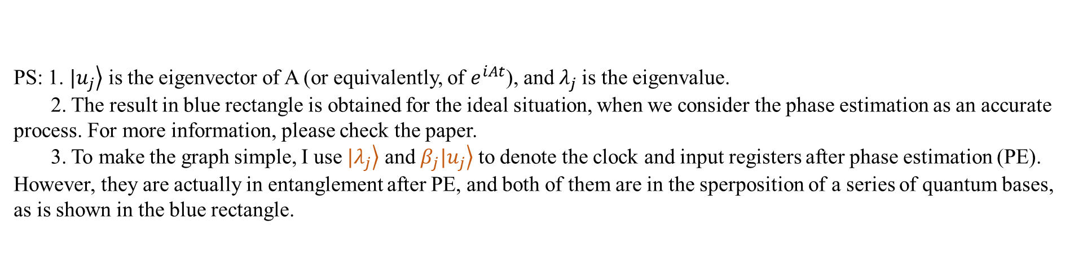
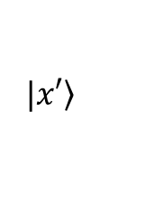

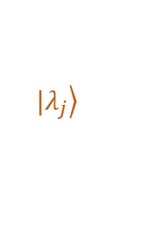


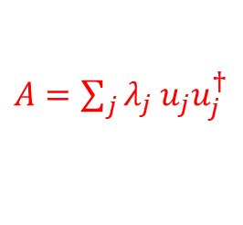
Step 3.
Decompose $|\left.b\right\rangle =\sum_{j=1}^{N}{β_{j}|\left.u_{j}\right\rangle }$ in the eigenvector basis, using phase estimation.
The procedure for HHL algorithm
$$|\left.λ_{j}\right\rangle$$
$$β_{j}|\left.u_{j}\right\rangle$$
$$|\left.x′\right\rangle$$
$$A→U= e^{iAt}$$
$A=\sum_{j}{λ_{j}}$ $u_{j}u_{j}^{†}$
$$\sum_{j=1}^{N}{β_{j}|\left.u_{j}\right\rangle \left.|λ_{j}\right\rangle }$$
PS: 1. $|\left.u_{j}\right\rangle$ is the eigenvector of A (or equivalently, of $e^{iAt}$), and $λ_{j}$is the eigenvalue.
2. The result in blue rectangle is obtained for the ideal situation, when we consider the phase estimation as an accurate process. For more information, please check the paper.
3. To make the graph simple, I use $|\left.λ_{j}\right\rangle$ and $β_{j}|\left.u_{j}\right\rangle$ to denote the clock and input registers after phase estimation (PE). However, they are actually in entanglement after PE, and both of them are in the sperposition of a series of quantum bases, as is shown in the blue rectangle.

Slide 5
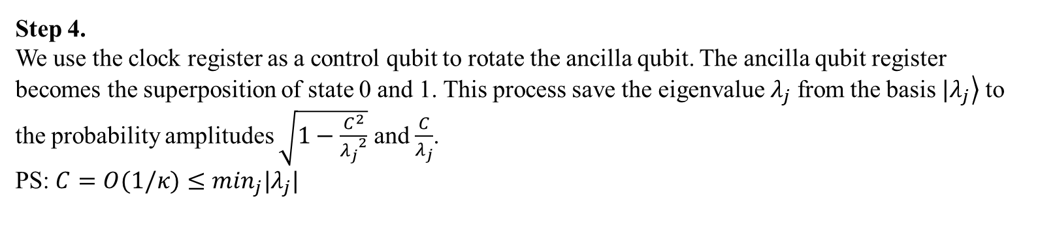
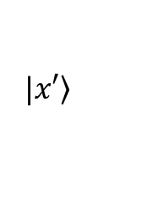
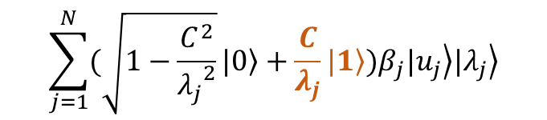


The procedure for HHL algorithm
$$\sum_{j=1}^{N}{(\sqrt{1−\frac{C^{2}}{{λ_{j}}^{2}}}|\left.0\right\rangle +\frac{C}{λ_{j}}|\left.1\right\rangle )β_{j}|\left.u_{j}\right\rangle \left.|λ_{j}\right\rangle }$$
$$|\left.λ_{j}\right\rangle$$
$$β_{j}|\left.u_{j}\right\rangle$$
$$|\left.x′\right\rangle$$
Step 4.
We use the clock register as a control qubit to rotate the ancilla qubit. The ancilla qubit register becomes the superposition of state 0 and 1. This process save the eigenvalue $λ_{j}$ from the basis $|\left.λ_{j}\right\rangle$ to the probability amplitudes $\sqrt{1−\frac{C^{2}}{{λ_{j}}^{2}}}$ and $\frac{C}{λ_{j}}$.
PS: $C=O(1/κ)≤\min_{j}|λ_{j}|$

Slide 6
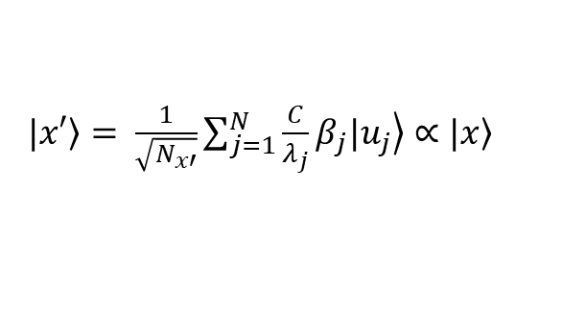

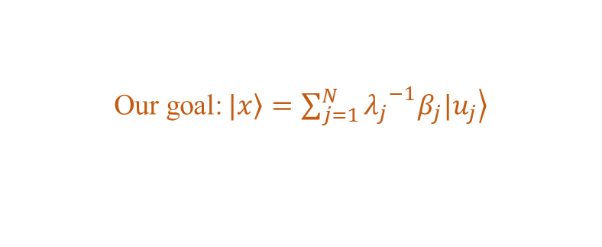



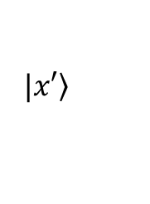
$$\sqrt{1−\frac{C^{2}}{{λ_{j}}^{2}}}|\left.0\right\rangle +\frac{C}{λ_{j}}|\left.1\right\rangle$$
The procedure for HHL algorithm
$$|\left.λ_{j}\right\rangle$$
$$β_{j}|\left.u_{j}\right\rangle$$
$$|\left.x′\right\rangle$$
Step 5.
Use inverse phase estimation to uncompute $\left.|λ_{j}\right\rangle$ ($\left.|λ_{j}\right\rangle →\left.|0\right\rangle ).$ Measure the ancilla register, if the result of measurement is $\left.|1\right\rangle$, we can get $\left.|x\right\rangle$. If the result is $\left.|0\right\rangle$, we need to recalculate.
PS: $N_{x′}=$ $\sum_{j=1}^{N}{(\frac{C}{λ_{j}}β_{j})}$
Our goal:$|\left.x\right\rangle =\sum_{j=1}^{N}{{λ_{j}}^{−1}β_{j}|\left.u_{j}\right\rangle }$
$|\left.x′\right\rangle = \frac{1}{\sqrt{N_{x′}}}\sum_{j=1}^{N}{\frac{C}{λ_{j}}β_{j}|\left.u_{j}\right\rangle ∝}$ $|\left.x\right\rangle$

